Slide 1


Fernie Valley Pathway
Paved Pathway from West Fernie to Fernie Alpine Resort
Preliminary Design
Presentation to City of Fernie Committee of the Whole
May 19, 2020
Darin Langhorst & Matt Hadley
Client liaison Kevin Mohr
Notes:
Other project participants
City of Fernie – Jenny Weir, Zabrina Pendon
Fernie Trails Alliance – Jason Sinclair, Terry Nelson
Various stakeholders as noted in the report

Slide 2
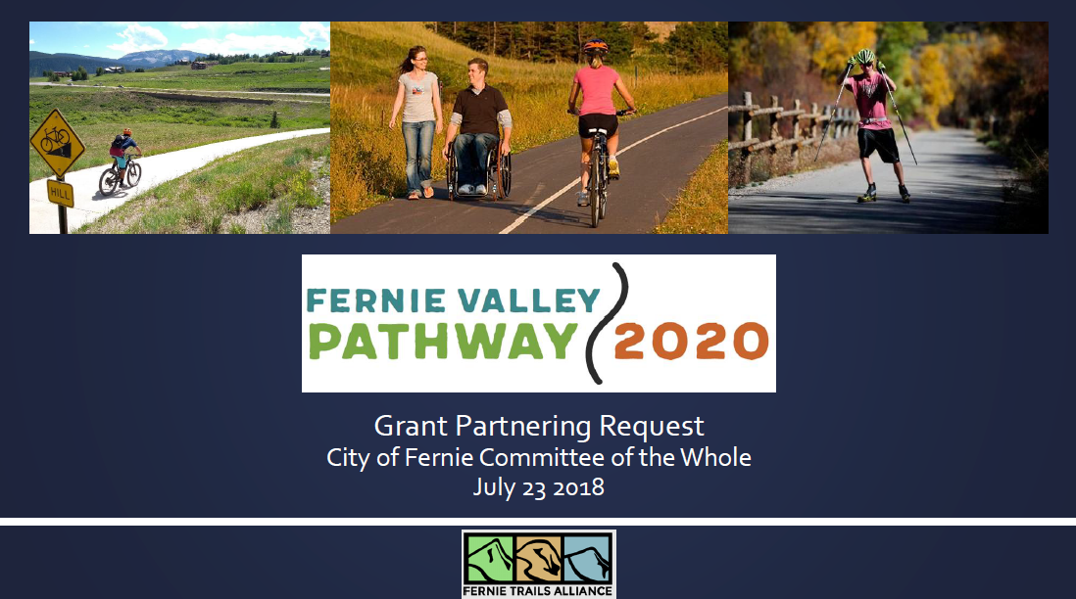
Notes:
Project previously presented July 2018 at Committee of the Whole to approve grant funding application for Preliminary Design.
This project is the outcome of the 2018 Committee of the Whole presentation.

Slide 3
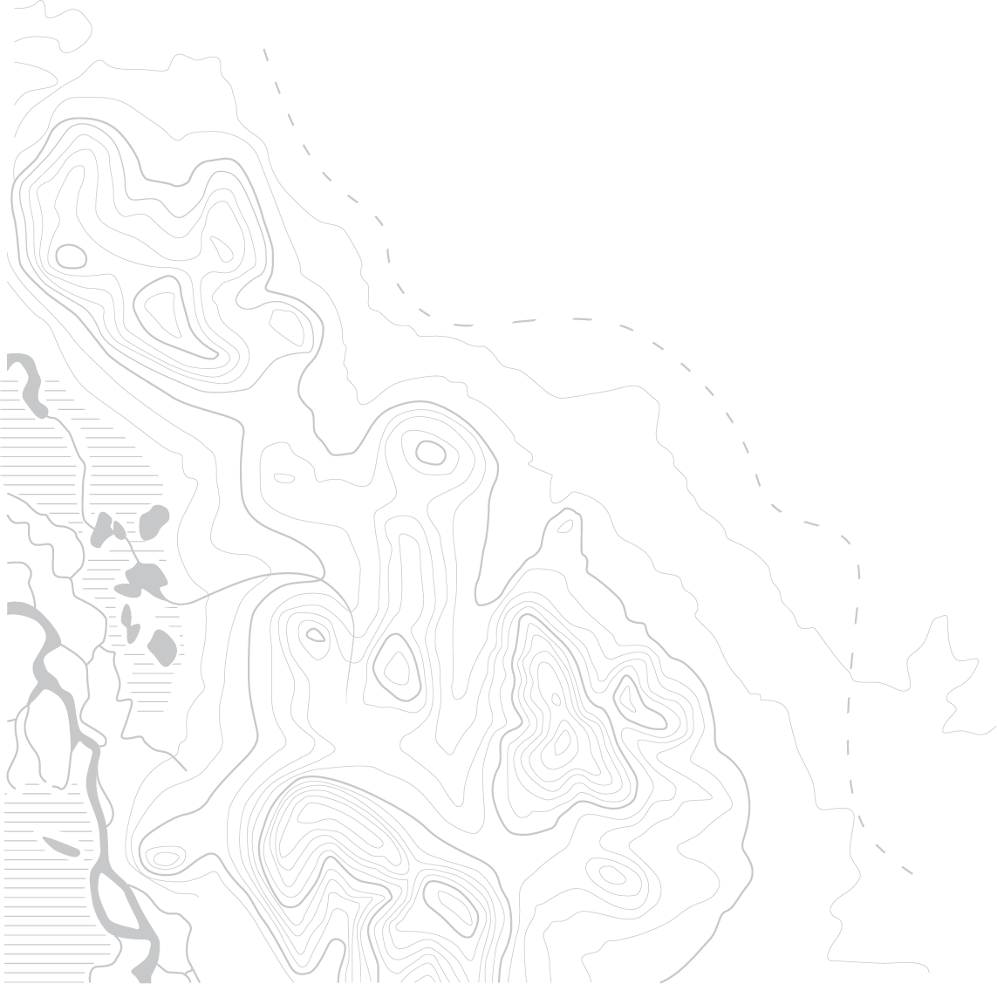
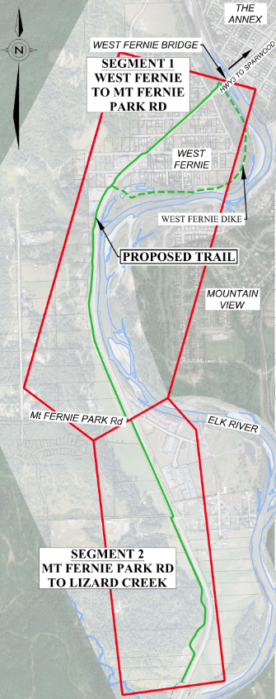
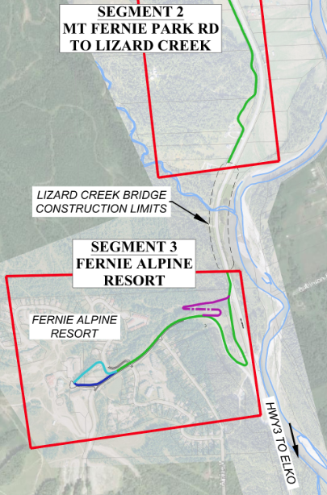
Goals of the Pathway
Connect Valley Communities
Active Transportation linkage for neighborhoods
Safer access to other trail networks and attractions
High value outdoor recreation/tourism amenity
Connect through the Lizard Creek Bridge multi-use pathway and bridge (under construction)
Outcome: 6.1 km paved multi-use pathway - safe and accessible travel within the community
Notes:
Neighborhoods of the Cedars, Riverside, West Fernie, connect them all to each other and to City of Fernie
Provide access to other trail networks, such as the MTB trails at Mt Fernie Provincial Park and FAR
Safety - pathway should be a separate facility with as little on-road path as possible; minimize road and driveway crossings
Construct rest of pathway so Lizard Creek pathway is not an orphan forever
Recreation on the pathway itself – walking, biking, running, small wheeled users
Broken into 3 segments for clarity – Segment 1 from the Elk River Bridge to Mt Fernie Park Rd, Segment 2 south to the Lizard Creek Construction, Segment 3 at Fernie Alpine Resort

Slide 4
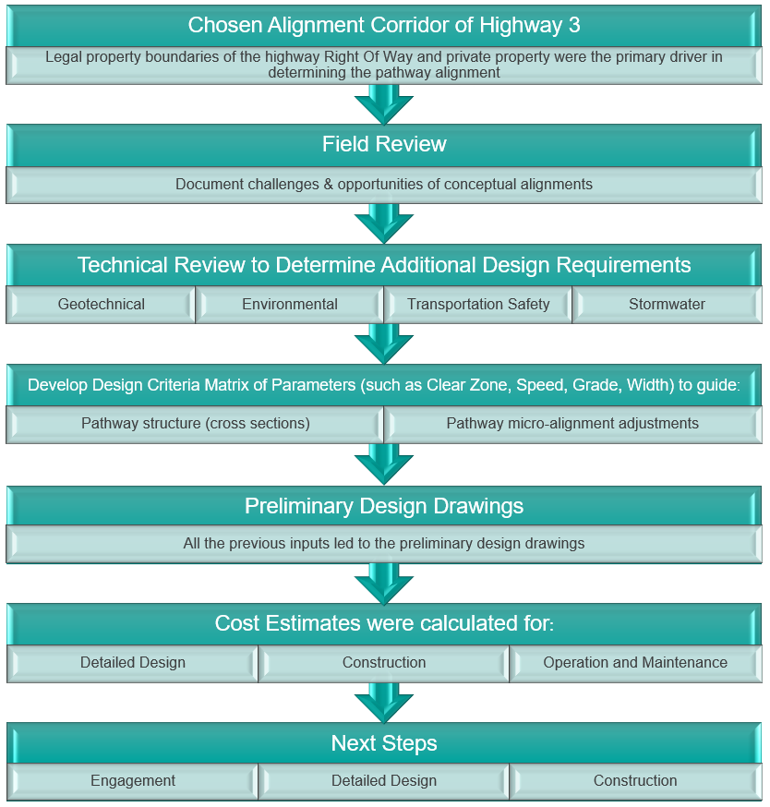
Project Approach
Notes:
Discuss the steps we followed to complete the project
Once we chose the alignment of the highway corridor we were constrained to a very narrow strip of land on the edge of the highway ROW and the private property

Slide 5
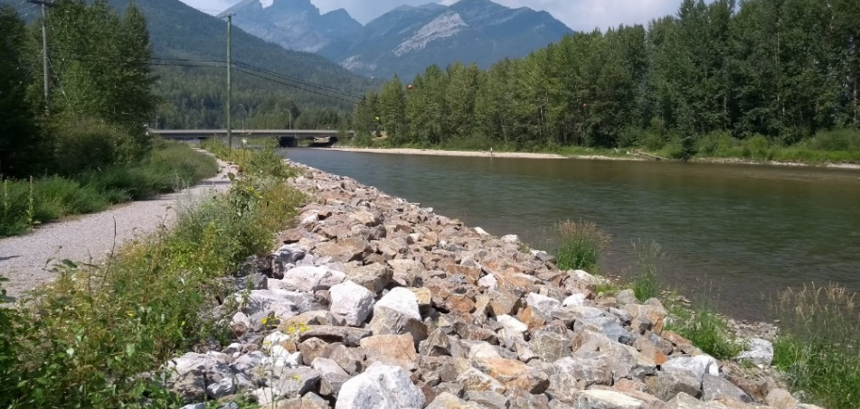
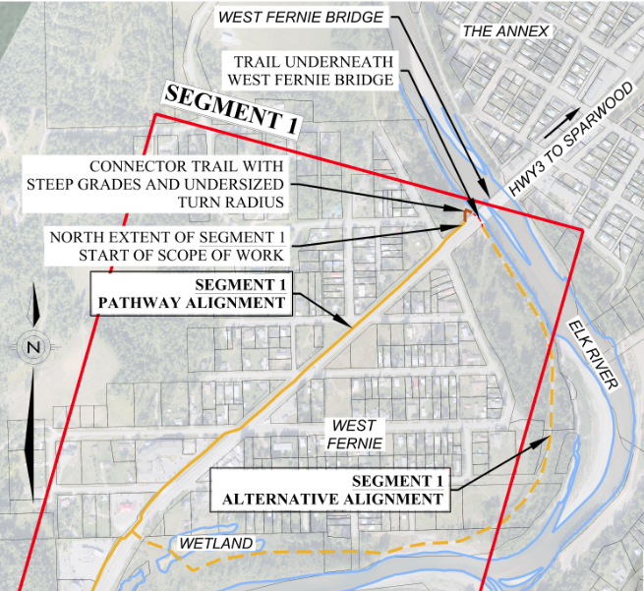
Segment 1: West Fernie Alignment Options
Highway 3
  Direct, central, out of floodplain
  Stays on west side of Hwy 3
West Fernie Dike
  Longer and limited connectivity options
  Future need to raise the dike
  Wetland crossing
Notes:
In West Fernie originally there were 2 conceptual alignments
we selected the HWY 3 option for the following reasons
More direct – BIGGEST GOAL is that a commuter pathway should be logical and direct. If we used the West Fernie dike users would still use the highway shoulder as it is more direct
The dike is not a route that commuters are going to take because it is not direct. It is out of reach of the north side of the hwy. It is a great recreational trail with river access/views, but is not an effective commuting route.
This results in fewer overall crossings of Highway 3 (Pathway always on the west side of the road)
Future need to raise the dike – however, inappropriate use of funds to pave it now and raise it later
Environmental concerns of existing wetland/riparian zone
Connections from various neighborhoods to the pathway will need to be considered during detailed design

Slide 6
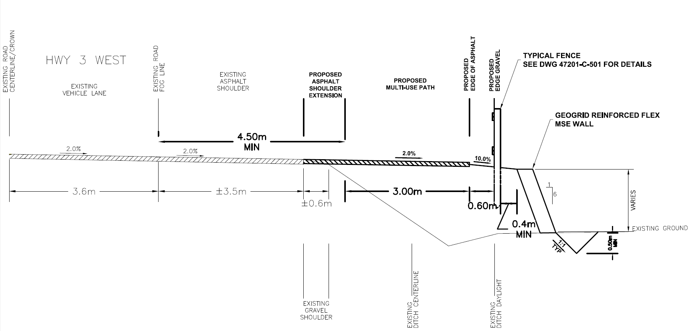
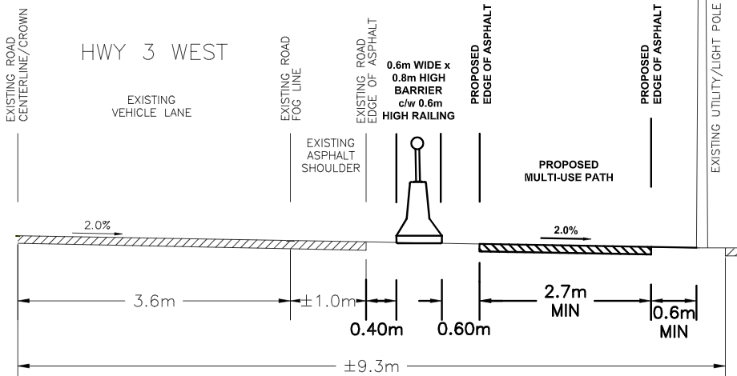
West Fernie Cross Sections
Notes:
From a literature review we created a design criteria matrix – these are design guidelines from the province
It included items such as how wide to make the pathway, how steep, and the clear zones and setback from the fog line
From the matrix, the shape of the existing highway shoulder/ditch/ground and the property line constraints we developed the pathway cross sections to fit that area
All based on MoTI approval
The lines in dark are proposed, light lines are existing
Darin – explain why 3.0m at north end vs. 2.7m further south (Section D at a legal boundary pinch point, narrow shoulder, no ditch, constrained)
Report has a more detailed discussion of the rationale for the upper section (fence is unavoidable but widening the road shoulder appears to be the most cost effective option, avoids $$$ barriers)
Section O and P 2.1 meter extra width requires additional engineered fill. Cost is $275 per m
Section D Roadside barrier, c/w railing, cost is $505/m
Exact trail cross section will be determined at detailed design stage

Slide 7
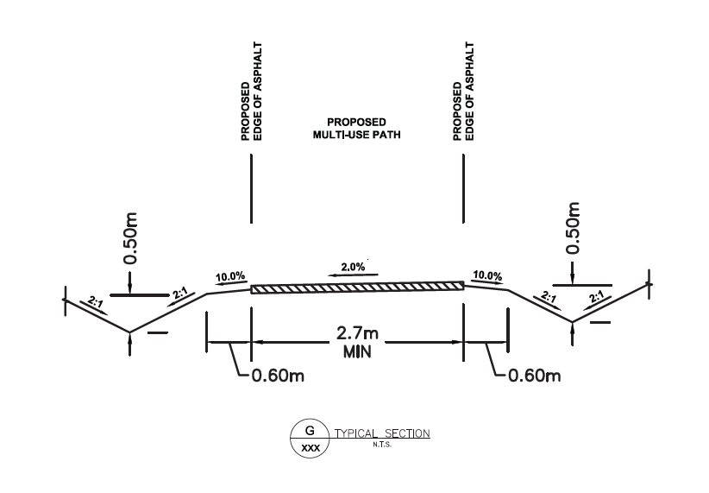
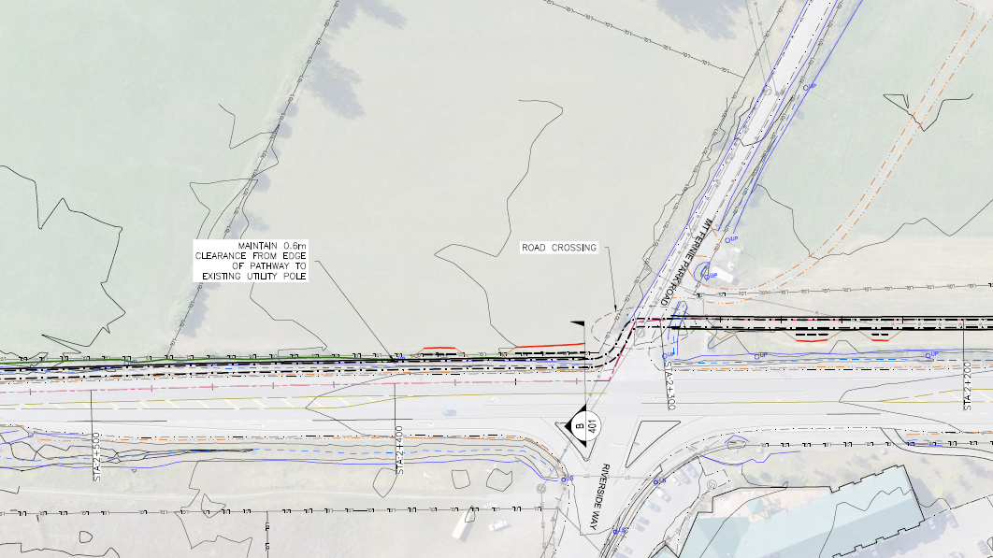
Segment 2: Mt Fernie Park Rd
Hwy 3 Crossing
Notes:
Includes pathway from south end of Segment 1 to the new work by BC MoTI at Lizard Creek
Where possible, pathway as far away from Hwy as possible but still in right of way to allow for future hwy widening. Try and keep trees.
Mt Fernie Park Road – Intersection will need collaboration from MoTI for crosswalk across Hwy 3. Will need input from BC MoTI for future planning of Hwy 3 corridor and intersection ugprades.
Where necessary, pathway along hwy shoulder – widen shoulder
From here south the pathway through RDEK is a similar cross section
- Only if questions - Right now we are not encroaching on the private property – functionally it works to be in the hwy ROW
Location of crossing to be done in conjunction with MoTI

Slide 8
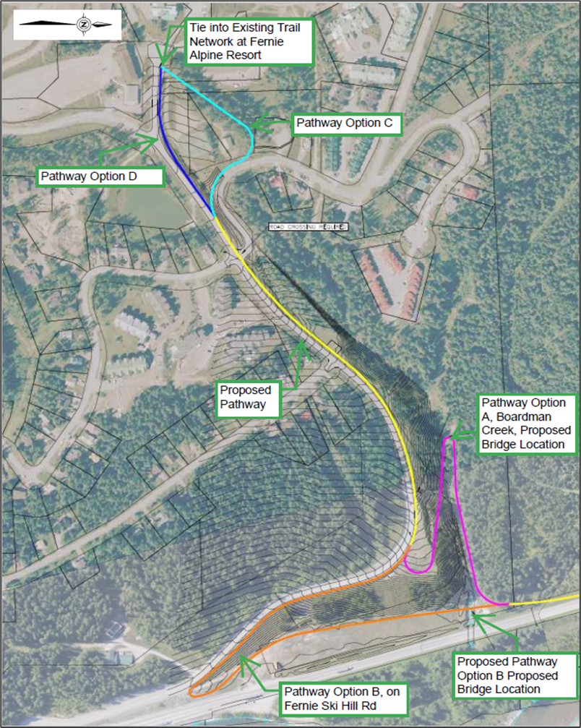
Segment 3: Fernie Alpine Resort Alignment Options
Boardman Creek Options
  More gradual grades
  More forest path experience
Fernie Ski Hill Rd
  Steeper grades
  Snow clearing challenges
Notes:
All options we do not know what the geotechnical requirements are in terms of pathway structure and design (retaining wall needs) and the potential slope stability constraints
Following Boardman Creek:
pros: more gradual, forest and stream experience away from vehicles, potentially shorter bridge.
Cons: chance of wildlife, chance of flooding, private land crossings required
Staying on road shoulder
Pros: known alignment, less new environmental disturbance
Cons: Steeper, Potentially more expensive snow clearing challenges

Slide 9
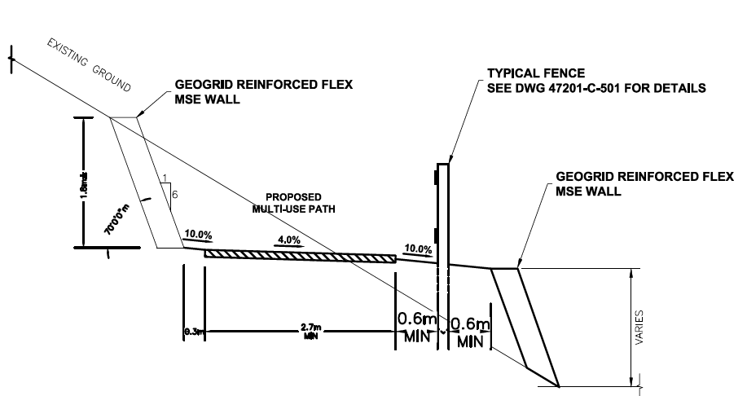
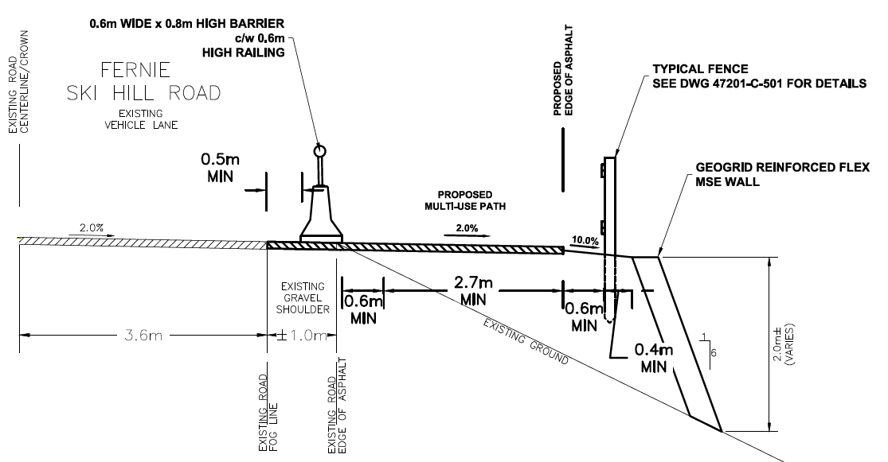
Fernie Alpine Resort Cross Sections
Notes:
Boardman creek cross section
Fernie Ski Hill Rd cross section
Both lower options have geotechnical uncertainty and risk in relatively steep terrain
Existing road section is not wide enough to accommodate and bi-directional multi-use path without adding pavement
Although a geogrid reinforced flex MSE retaining wall system was assumed, there are numerous ways a retaining system could be created
Both options will be complex, from a geotechnical standpoint.
Costs will be higher per lineal meter, where retaining is needed.

Slide 10
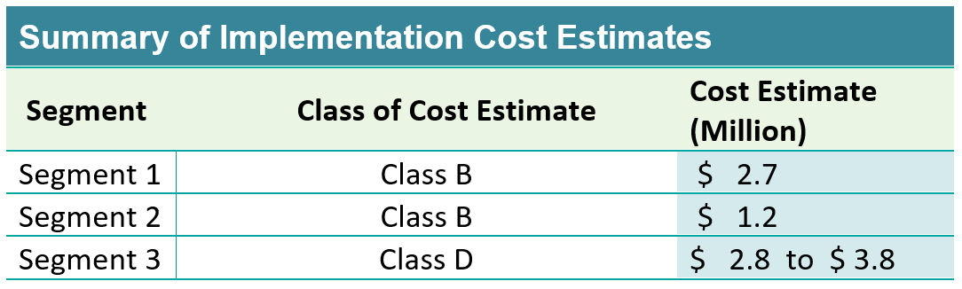
Notes:
This includes survey and detailed design
For Segment 1, the $2.7million includes the detailed design amount which is $251,000
Went to a class B for segment 1 & 2 because of higher certainty – the pathway really can’t get any longer and the constraints are fairly well known
Class D for FAR because of geotechnical uncertainty – meaning pathway structure uncertainty
1+2+3a+shared+3c = $6.9million low end of range
1+2+3b+shared+3d = $7.4million high end of range

Slide 11
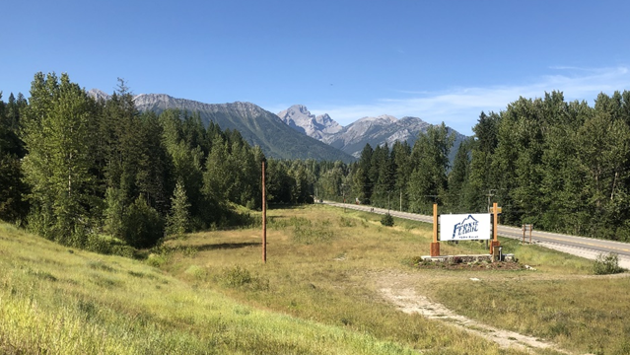
Next Steps
Funding Strategy and Implementation Plan
Detailed Survey
Detailed Design for Segment 1
Landowner and Public Engagement
BC MoTI approvals, other approvals
Construct Segment 1
Continue and repeat process with Segments 2 & 3
Notes:
The final sections of the report include a list of NEXT STEPS
Some steps are predecessors to other steps, for example detailed design must be done before tendering the project
Other tasks can be done concurrently, such as detailed design and public engagement
Phasing is based on completing the segments beginning at eh north end and working southward: Segment 1, 2, then 3

Slide 12
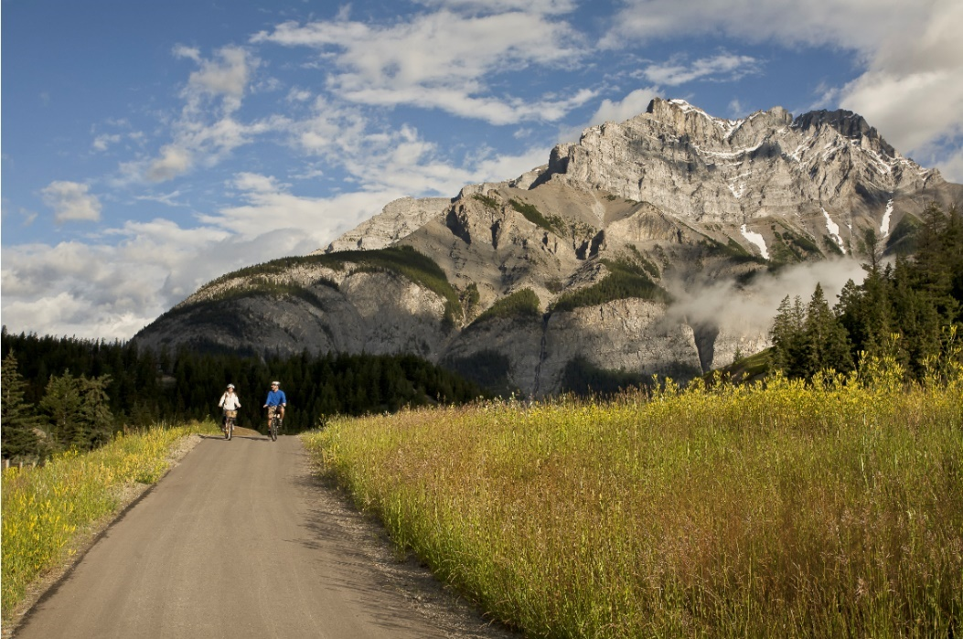
Questions?
Darin Langhorst, P.Eng., BFA
403-621-4072
dlanghorst@mcelhanney.com
Kevin Mohr, P.Eng.,
250-425-0158
kmohr@mcelhanney.com
Matt Hadley, BSc.
403-621-4074
mhadley@mcelhanney.com

Slide 13

keep slides below in case of questions about these topics

Slide 14
Segment | Annual Total of Operation and Maintenance and Capital Reserve Contribution
Segment 1 only constructed (Includes all of the Condition Review, Management, and Administration Tasks as this does not scale proportional to length) | $41,300
Following Completion of the Entire Pathway
Segment 1 | $30,520
Segment 2 | $17,500
Segment 3 | $14,100
Notes:
We created an annual operations and maintenance cost estimate
Numbers are based on a large study done in the states on rails to trails, the west side legacy trail in Invermere, and the North Star trail in Cranbrook.
This includes a contribution to capital reserve for re-paving in 35 years
Snow clearing for winter maintenance is included for segment 1 only to Mt Fernie Park rd.
The first row is if only segment 1 is constructed, it is higher because the admin costs are all still required
The next three rows are for when the entire pathway is constructed

Slide 15
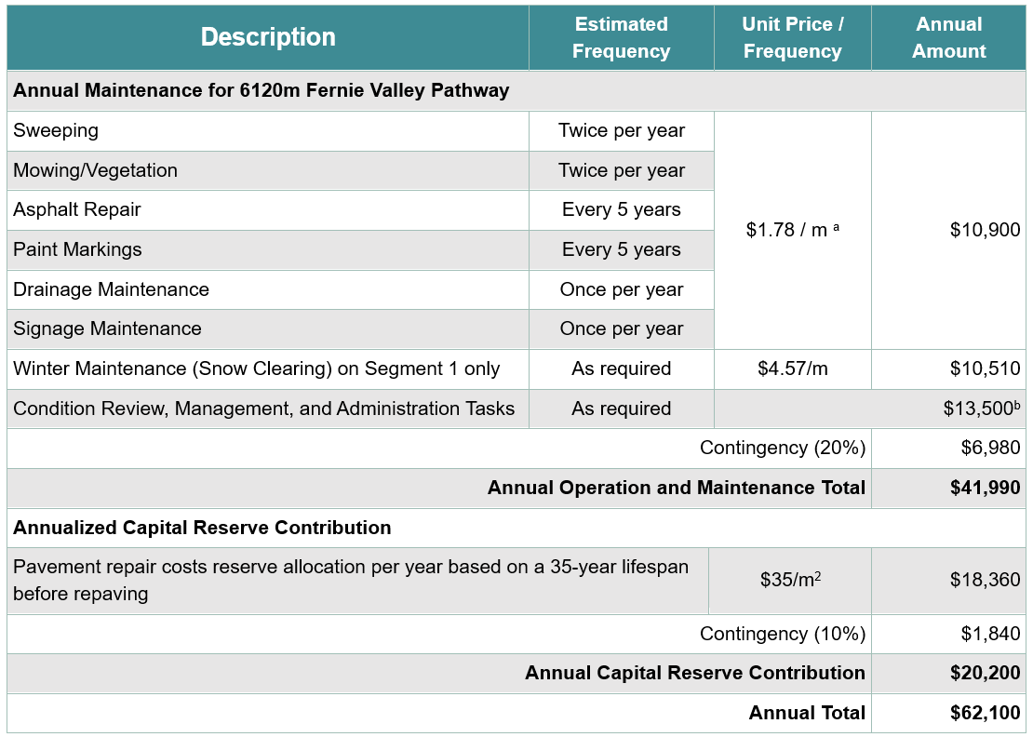

Slide 16
West Fernie Cross Section Cost Comparison
Section | Element | Cost per meter of Pathway Section
Section O and P | 2.1 meter extra width requires additional engineered fill. | $275
Section D | Roadside barrier, c/w railing | $505

